Slide 1
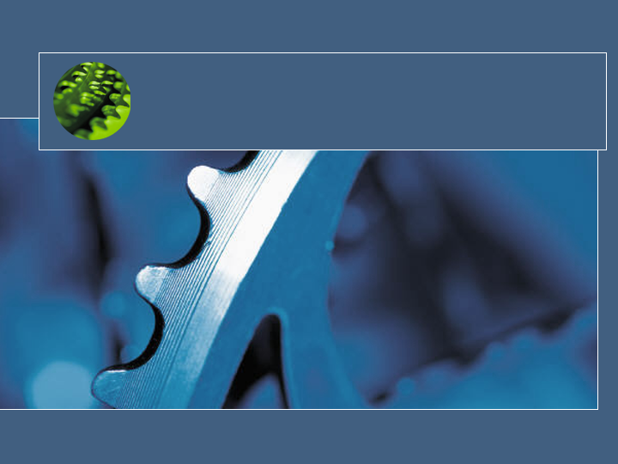
Exploring new OS Research through Singularity
“... it is impossible to predict how a singularity will affect objects in its causal future.”
- NCSA Cyberia Glossary
Galen Hunt
Microsoft Research

Slide 2

What is OS Research?
My definition:
  Research into the base abstractions to enable computation
  Research into implementations for those abstractions (the OS).
OS Research from 1970 is insufficient today.
  OS has adapted to some hardware changes (SMP, Net, etc.)
    But not the proliferation of cores (GPUs, NICs, etc.)
  OS hasn’t adapted to software changes:
    1970 Unix Application vs. Windows Application.
  OS hasn’t adapted to security changes.
    Web-based code, faulty device drivers, utility computing, etc.
Processes, threads, file systems, etc. are probably still relevant.

Slide 3
Singularity
New Research OS
  Platform for new OS research agenda
  Common laboratory for the NP cross-group research project into software development w/ PPRC.
Managed code all the way down.
  Written in SpeC#
    Superset of C# (formerly A#)
    Pre and Post Conditions, Invariants, etc.
  Bartok runtime (for MSIL) on bare metal.

Slide 4
OS Research Agenda
Adopt an abstract instruction set (Safe MSIL) as the system binary interface.
Add OS abstractions for Ubiquitous Metadata
Rebuild the OS security model from top to bottom.
Reengineer the OS Development Process
Reexamine other OS areas changed by 1-4.

Slide 5
Abstract
Instruction Set
Safe MSIL is the universal OS binary interface
  Drivers, applications, etc., all arrive as Safe MSIL.
  Language Safety and Isolation
  ISA neutral and Structured Metadata
OS controls translation to native code.
  Generate qualitatively different code from source MSIL
    Translate for security vs. performance:
      buffer overflows, stack walking, NX, SFI, etc.
    Ubiquitous on demand instrumentation:
      asserts, profiling, debugging, Vulcan, etc.
  Rethink traditional hardware security boundaries.
    Inline privileged operations into non-kernel code.
Notes:
Observation:
Role of OS is to abstract (virtualize, idealize, and structure) hardware.
Address Space (MMU) → Virtual Memory,
Disk →File System,
CPU Isolation → Process,
CPU Cycles → Threads
Abstract CPU Instruction Set have been used only for CPU architecture neutrality.
There is a lot of duplication of effort between the CLR and OS
Memory Management, Threading, Synchronization, Security, Process Model, etc.

Slide 6
Ubiquitous Metadata
Make metadata a first class, protected OS feature.
  Hang extensible metadata off all named OS entities.
    processes, threads, handles, files, security principals, etc.
  Strong typing and schemas for OS interfaces
    registry, ioctls, /proc, etc.
  Unify OS metadata APIs
    for enumeration, change notification, security, etc.
Add OS abstractions to bridge metadata gaps.
  (Program → Process) is like (Class → Instance)
Enable complete static analysis of OS and applications
  at compile and deployment time
  for verification, optimization, versioning, etc.
Notes:
Observation:
Persisting and managing metadata is a powerful primitive.
Java: Reflection is a powerful programming facility.
Marshaling, debugging, interpreters, etc.
CLR: User extensible reflection adds more power.
Custom marshalling, thread access, data management, transactions, programmer annotations, runtime extensions, etc.
WinFS adds metadata to the file system for the shell.
Storage is a lot cheaper than it was 30 years ago,
OS can afford to save and process metadata.

Slide 7
Rebuild
The OS Security Model
Remove drivers from the TCB
  Reify driver/service trust relationships.
  Hardware to ensure memory safety (DMA “MMU”).
Remove Administrator from the TCB
  Reify user trust relationships.
  Orthogonal Management
    Kernel (OS Vendor) as Trusted Third Party
  What is “complete” solution for NGSCB scenarios?
Simplify security management
  Deep isolation mechanisms.
  Eliminate partial redundancies between OS and Runtime.
Notes:
Observations:
Current security models don’t map to usage scenarios like:
Web-based code
Utility computing (division of resources, leasing, privacy)
Security is incredibly hard to manage.
OS has huge liability because it includes drivers in the TCB
Drivers are the #1 source of Windows blue screens.
Many drivers are written by first-time developers.
OS extension model forces many application into device drivers.
DRM is a fact of life
NGSCB is a engineering solution to a research problem.

Slide 8
Reengineer the OS Development Process
Software 2010 Grand Challenge
  “Routine to build secure, reliable, and maintainable applications & systems”
NP (New Project with Name Pending):
  Cross group research project
    OS, SWIG, SBT, FSE, ACT, etc.
  Explore co-evolution of OS and tools.
    Structure OS code to meet tools half way.
    Push tools research into design and deployment phases.
  Cooperating independent teams
    focus on own research domain
    share problems, solutions, people, ideas with other groups
Notes:
Unix and C were shaped through synergistic co-evolution.
Static analysis techniques such as model checking have advanced dramatically in the last decade.

Slide 9
Reexamine
Other OS Areas
What should be the boundary between user and kernel code?
What should a process look like?
What traditional OS APIs can unified, replaced, or simplified by the Metadata APIs?
How can we harness the proliferation of CPU cores in modern hardware?
Should we push transactions deep into the system?

Slide 10
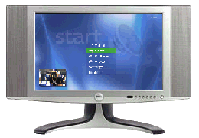
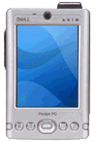

Target Scenario
eHome digital-convergence
  Diverse environment with little platform legacy
    Smart remotes, set top boxes, and media servers.
    Devices come and go. Storage comes and goes.
    Wide variety of form factors. One OS.
    Soft real-time and distributed requirements.
  Trustworthy, open software platform.
  Zero on-site human administration.

Slide 11
Architecture
Host Context
Guest Context
User Programs
User Programs
User Programs
User Programs
User Programs
User Programs
MSIL Verifier &
Code Generators
Guest
Code
User Programs
User Programs
User Programs
User Programs
User Programs
User Programs
MSIL Verifier &
Code Generators
User Programs
Daemons
File Systems
Network Protocols
Device Drivers
Metadata Providers
MSIL Code
Translators
Processes
Kernel/Runtime
Scheduler
IPC Manager
I/O Manager
Virtual PC
“Additions”
Trusted Computing Base
GC & Memory Mgr.
Metadata Manager
Security Manager
HAL
VM Manager
VPC VMM
Native HAL
Processors and Other Hardware

Slide 12
Demo

Slide 13
Demo Description
What you just saw:
  Bitmaps (1 per slide) statically linked to Singularity kernel
    Rendered with safe device drivers.
  Compiled MSIL running on bare metal.
  Network boot of Singularity from minidump via PXE.
What you didn’t see (’cause it ain’t there yet):
  Threads or a scheduler
  Interrupts (drivers are polling)
  Virtual memory, IPC, or a network stack
  Metadata
For more info, see http://singularity.

